Slide 1
Round Table presentation
By Max Zhang

Slide 2
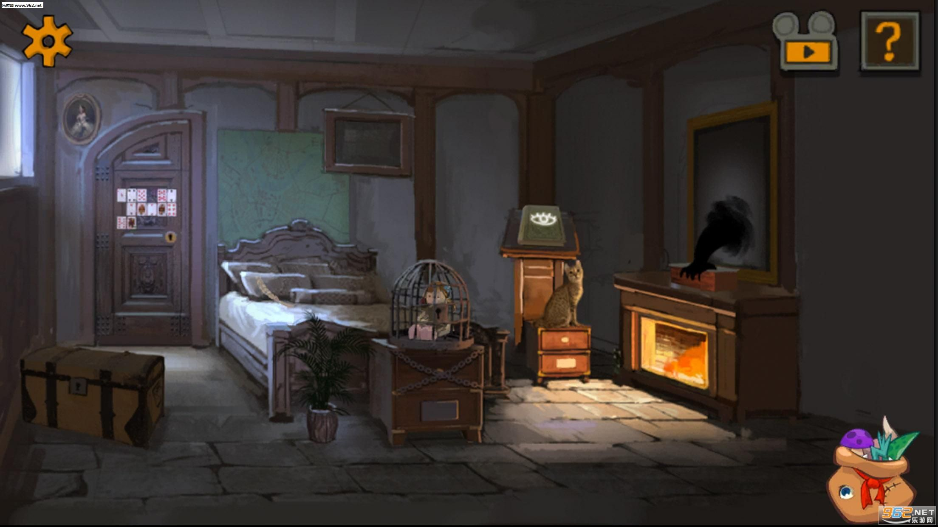
Escape room

Slide 3
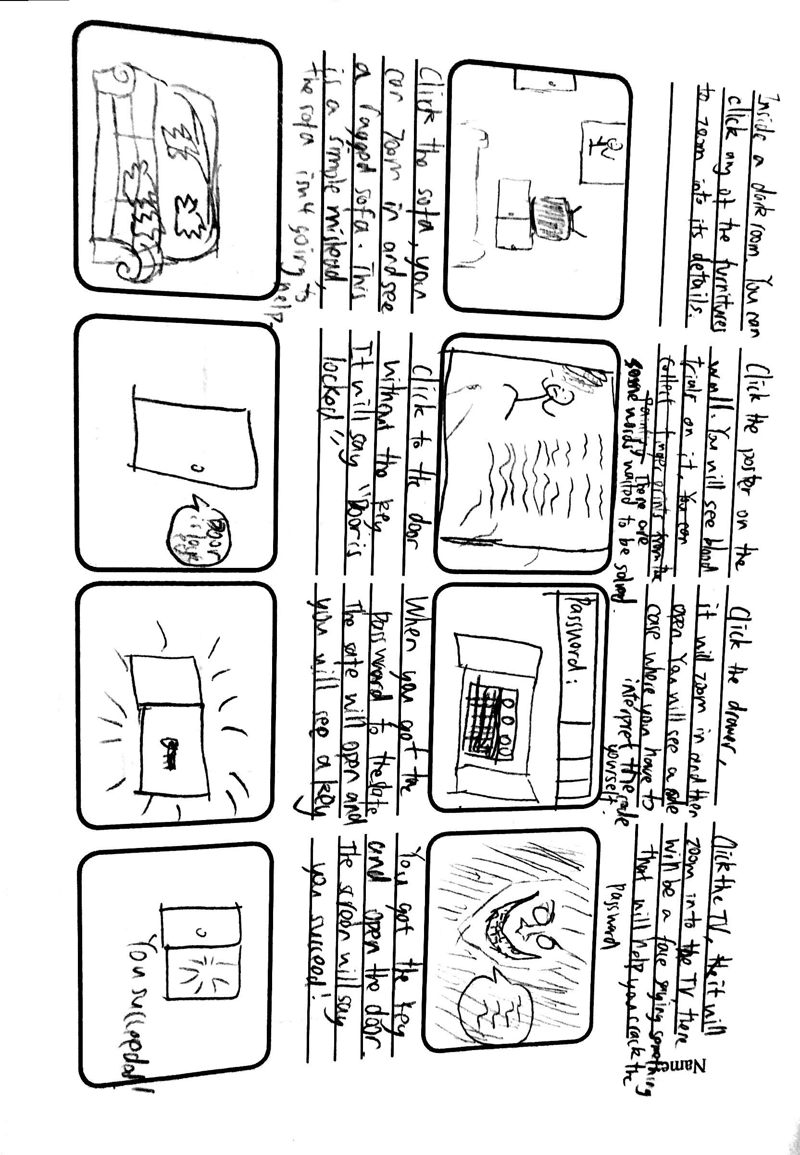

Slide 4
Introduction
The tone of the game will be like Five Nights At Freddy's by Scott Cawthon. It's a horror game. Although my game is an escape game, It will have a scary atmosphere.
The game is an escape game, you win by figuring out the puzzels and getting out of the room.
https://www.youtube.com/watch?v=RP4UTOek0-Y

Slide 5
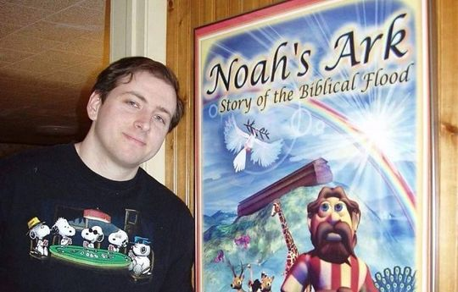
Scott Cawthon

Slide 6
Inspiration of sketch
https://www.openprocessing.org/sketch/527377

Slide 7

Miner

Slide 8
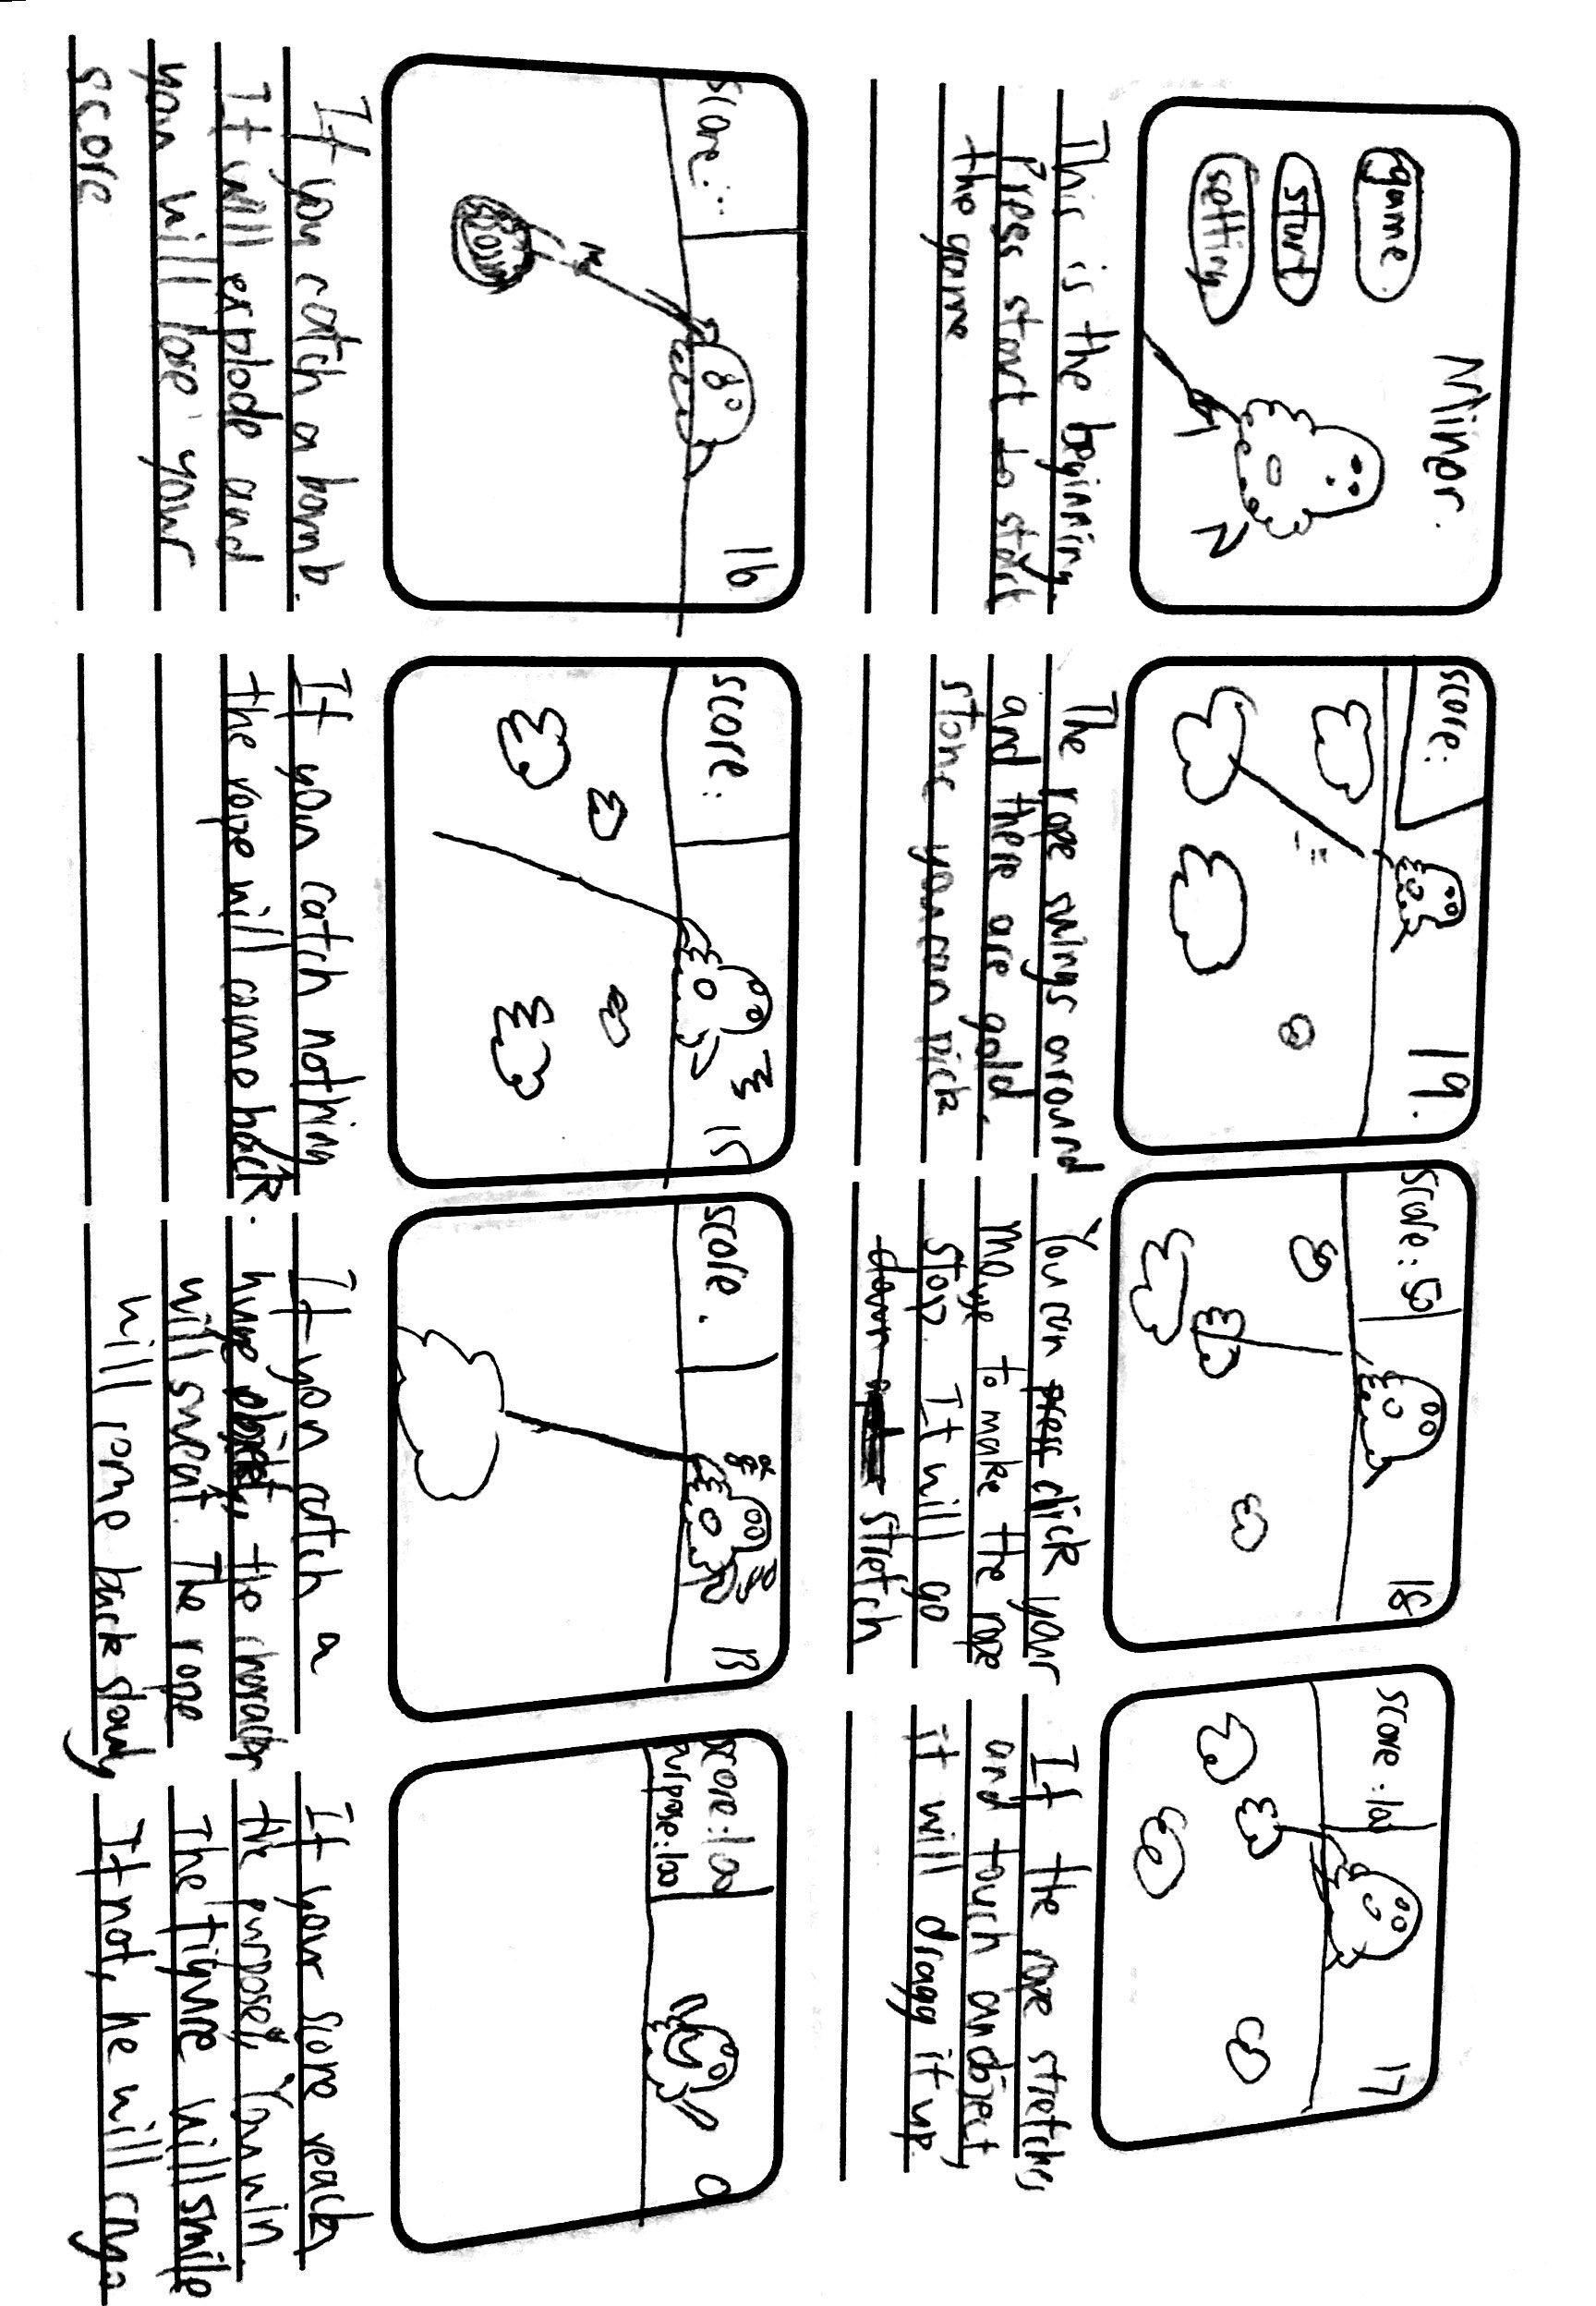

Slide 9
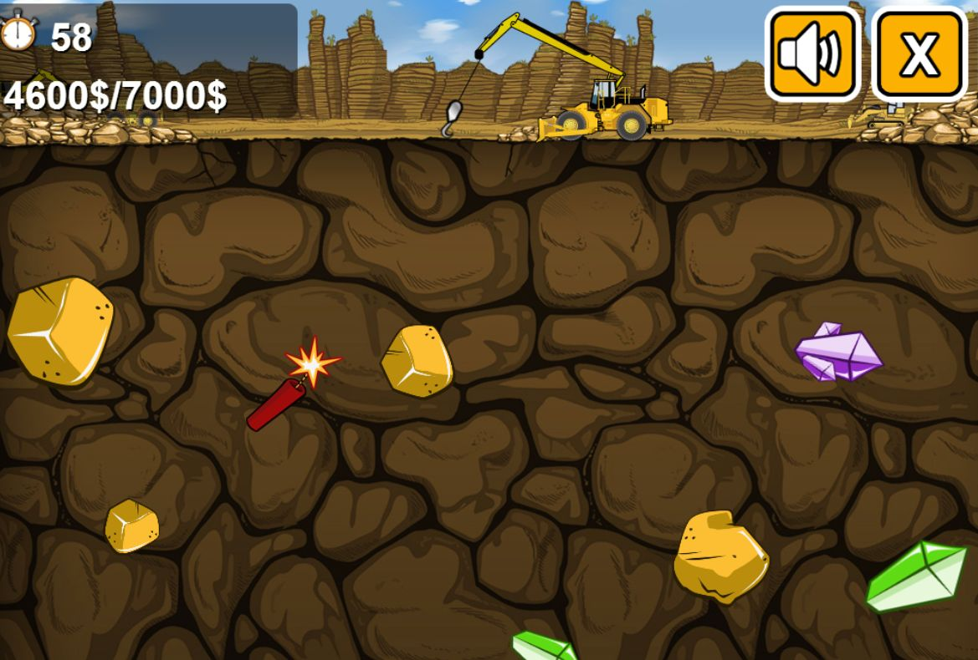
Introduction
The game is inspired by gold miner. A small game I often play from my childhood
https://www.crazygames.com/game/gold-miner

Slide 10
Inspiration of the sketch moves
https://www.openprocessing.org/sketch/594153

Slide 11
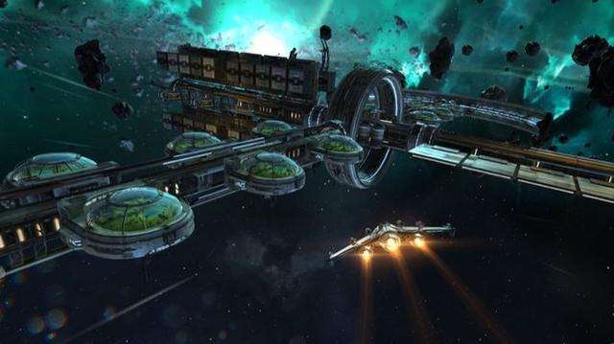
Star war

Slide 12
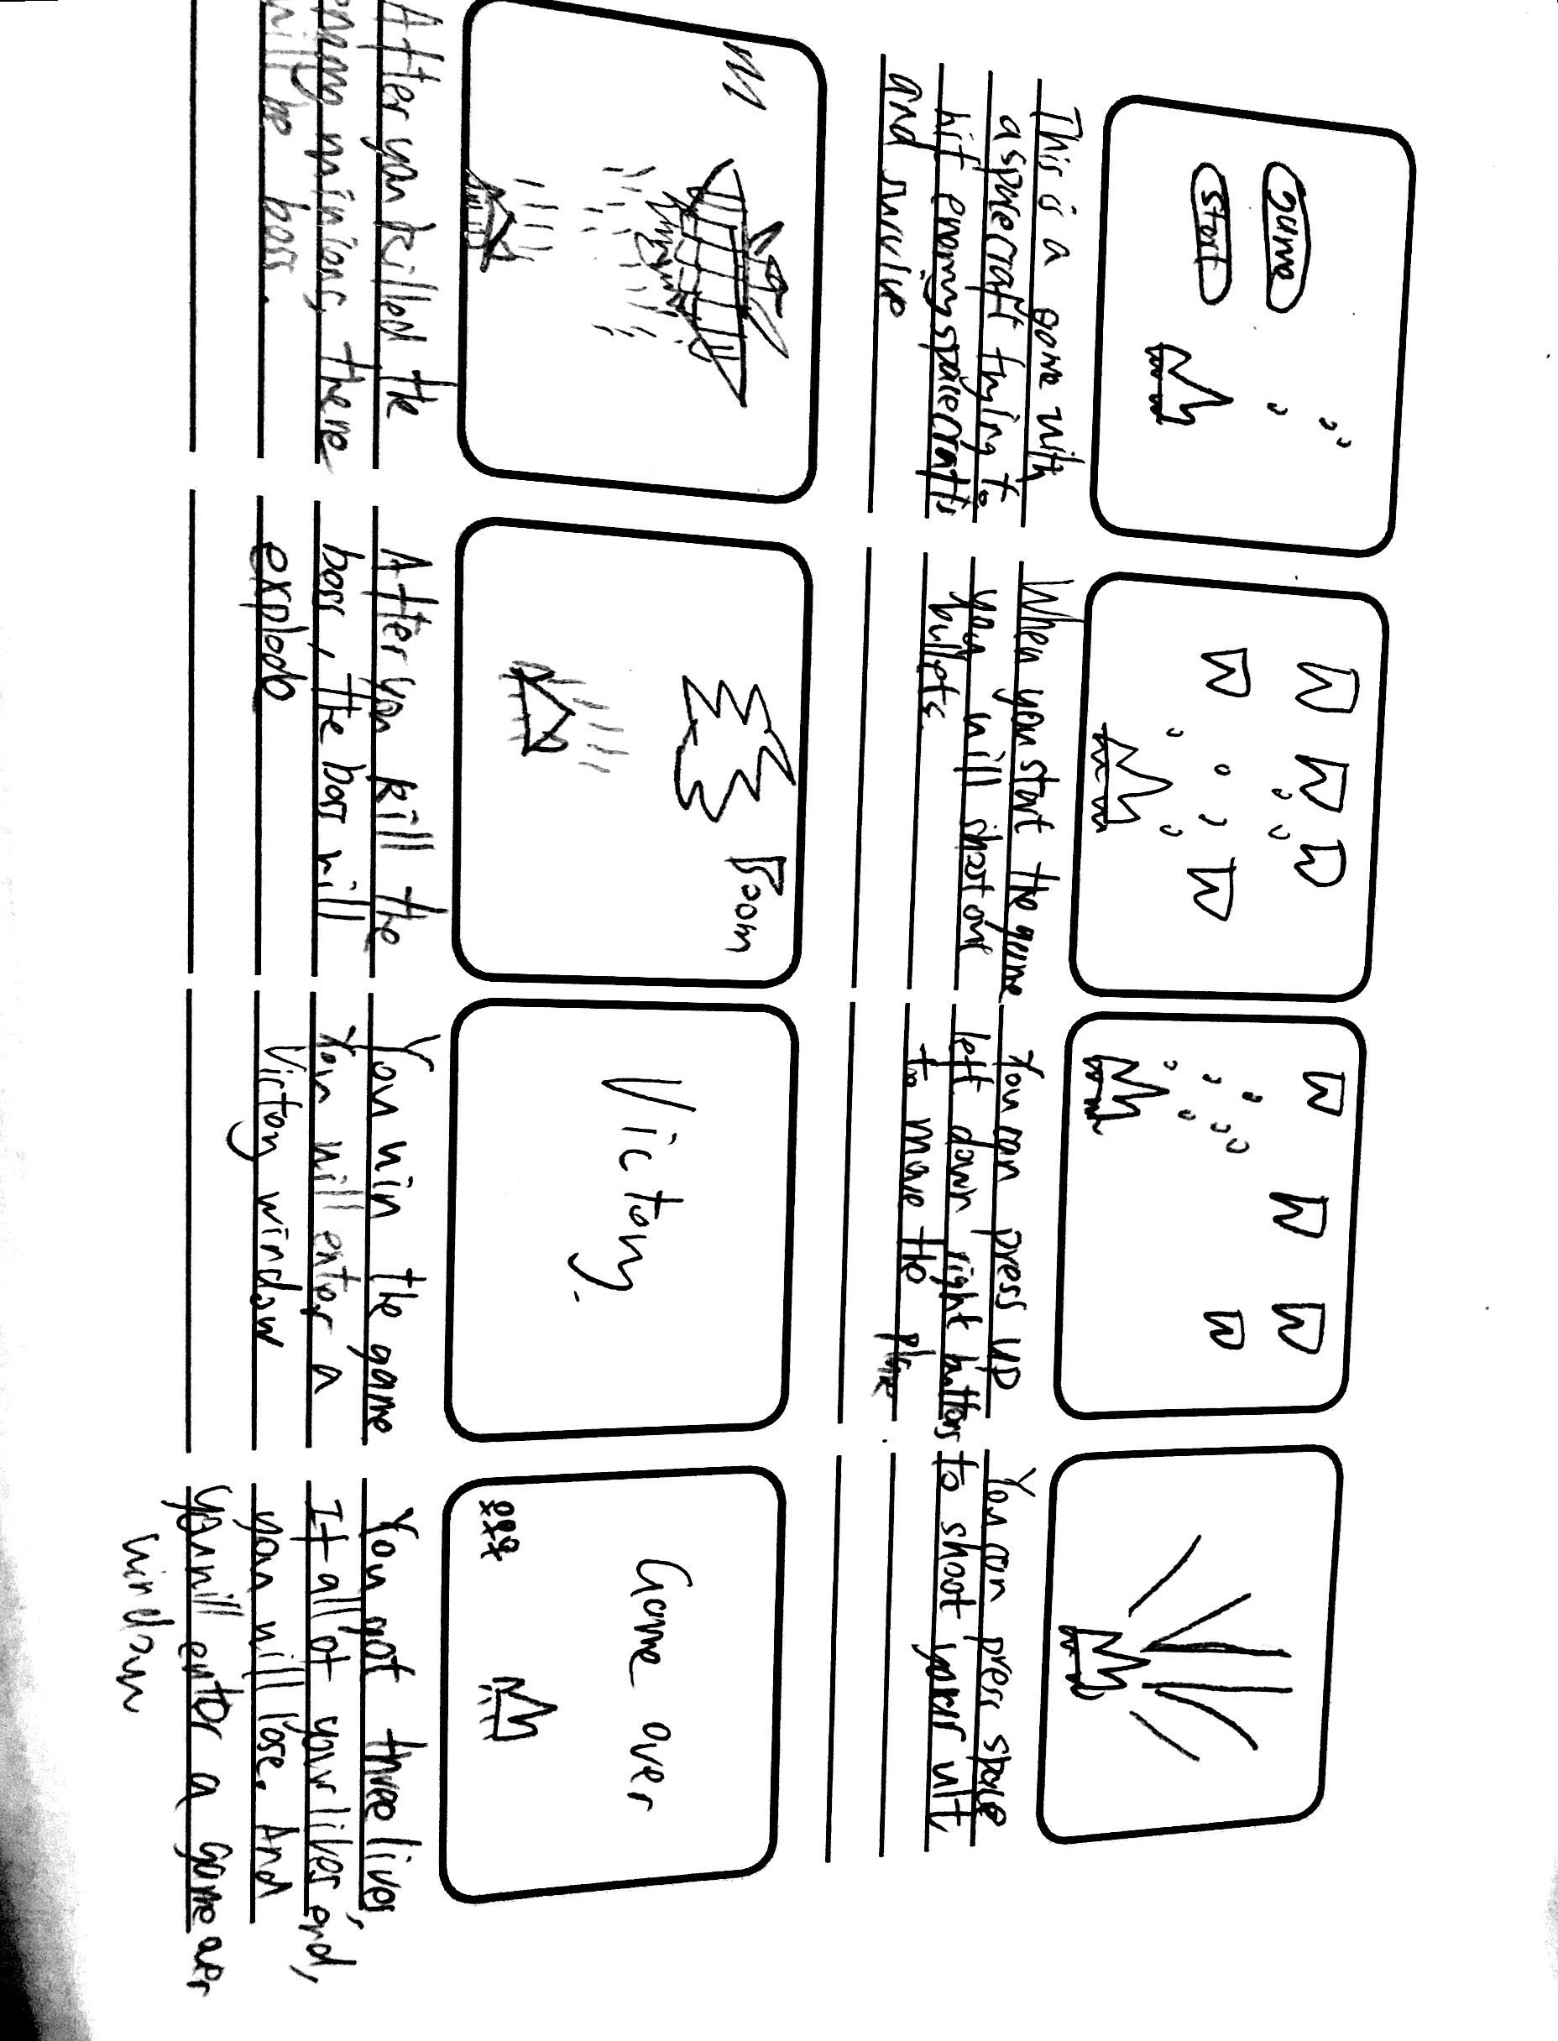

Slide 13
Introduction
The game is about a spacecraft hitting enemy spacecrafts
The game is inspired by a tiny game called thunder
http://www.4399.com/flash/144898_4.htm

Slide 14
Inspiration of sketch moves
https://www.openprocessing.org/sketch/575694

Slide 15
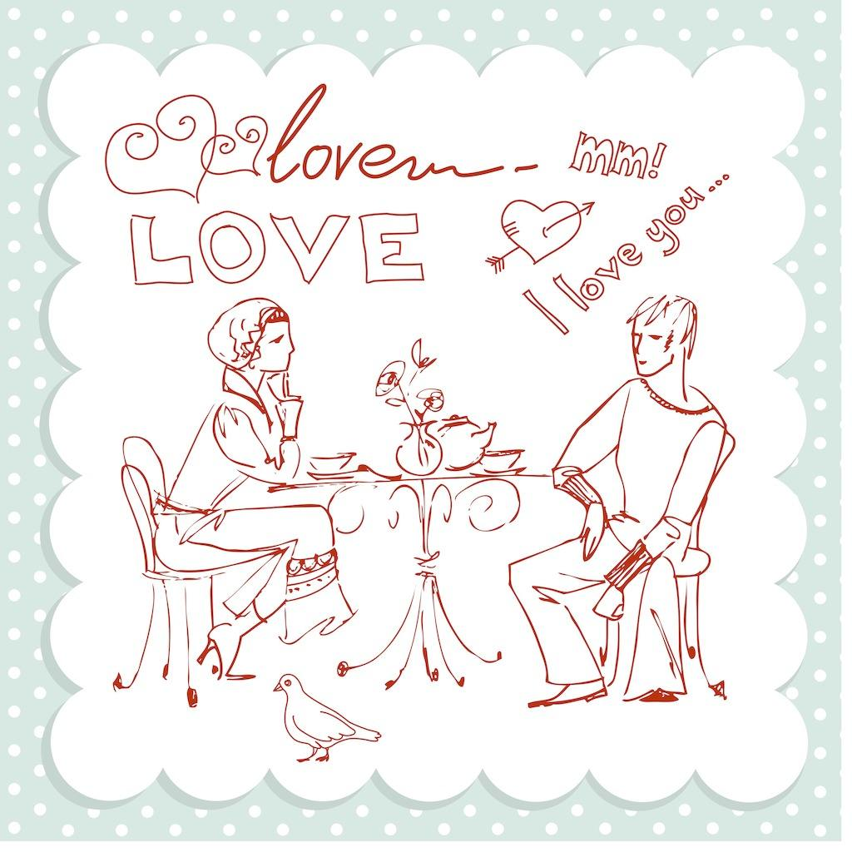
Love story

Slide 16
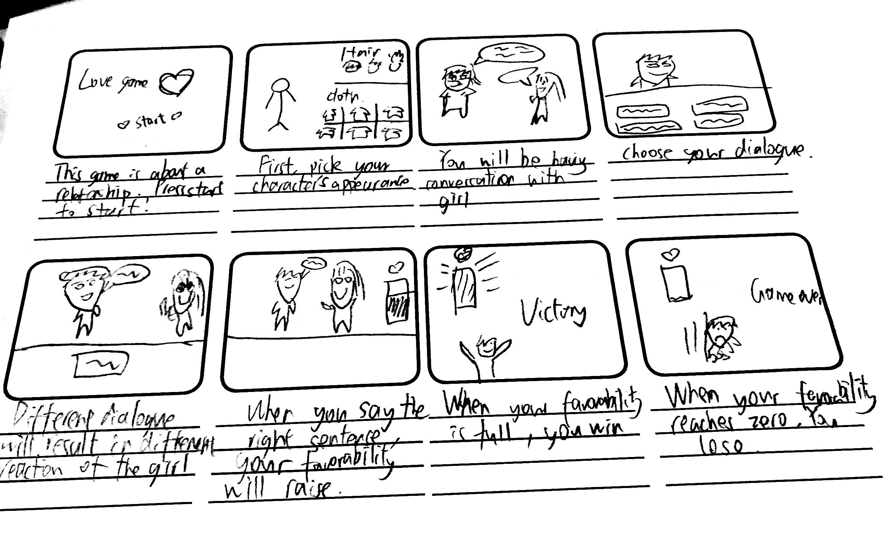

Slide 17
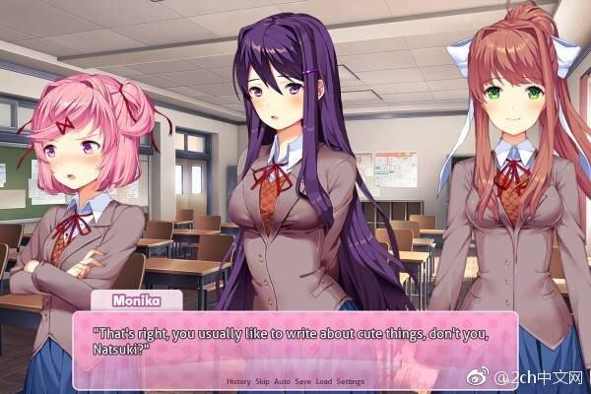
Introduction
Love story is a game about handeling a relationship through choosing dialogue or conversation
This kind of game is originated from Japan, and is called Galgame.

Slide 18
Inspiration of sketch moves
https://www.openprocessing.org/sketch/490461

